Slide 1

DEPRESSION DETECTION SYSTEM
TEAM 4-C CSE-C
Raza Abbas : 19PA1A05F7
T. Vidya Anusha : 19PA1A05H6
P. Taraka Sai Pavan : 19PA1A05E2
P. Sai Sashank : 19PA1A05D3
Guide Name : Mr S. Mahaboob Hussain

Slide 2
Abstract
Depression is a leading cause of mental illness, and it has been linked to an increased risk of premature death. Furthermore, it is a major contributor to suicidal thoughts and causes significant impairment in daily life. Every year, one in every 15 adults suffers from depression.
Globally, the total number of people with depression was estimated to exceed 300 million in 2015.

Slide 4
Existing Vs Proposed System
Existing System Drawbacks
Proposed System
The user can take self-tests to know what type of depression they are suffering from.
An Alert Is sent to the admin whenever any user is found out to have any type of Depression.
The existing system is unable to detect the symptoms of depression accurately.
Glitches in identifying emotions generally lead to flawed outcomes.

Slide 5

Scope
It finds its usage especially among kids , this system can alert the teacher or guardian if a child is depressed.
With the emotions and text detectors embedded in this system, individuals can identify whether they are going through depression or not, if yes, then it can also detect the type of depression.

Slide 6
Feasibility Study
All necessary technology exists to develop the system.
Our project is technically feasible because, all the technology needed for our project is readily available.
This system can give guarantees of accuracy, ease of use, reliability and the data security.
Our project is economically feasible because the cost of development is very minimal when compared to financial benefits of the application.

Slide 7
Hardware and software requirements
Minimum Hardware requirements
Windows 7 or higher
I3 processor system or higher
4 GB RAM or higher
100 GB ROM or higher
Minimum Software requirements
Python
Sublime text Editor
XAMP Server

Slide 8
Module Description
Teacher/Admin:
Login:
The admin can log in using their credentials.
Manage Students:
They can Add, Update, Delete, and View students.
They can view the details of the students with depression.

Slide 9
Module Description
After the admin add the new user details, the user will receive an email about the username and password.
Manage Info:
The admin will add information about mental diseases.
Student/User:
Login:
The user can log in to their account using their credentials.

Slide 10
Module Description
Upload a Video:
A real-time camera will open and the user will have to say something about themselves for 1 minute and their facial emotion will be detected.
The user will make different emotions at times, for each emotion there will be a score given to detect Depression (based on sad/fear/anger/disgust).

Slide 11
Module Description
If Depression is detected then
The user will answer the quiz.
Self-tests With quiz
After the quiz, the results will be displayed saying which type of depression is there (it can be Depression, Anxiety, PTSD, or Bipolar), and an Email will be sent with the results (one static email)

Slide 12
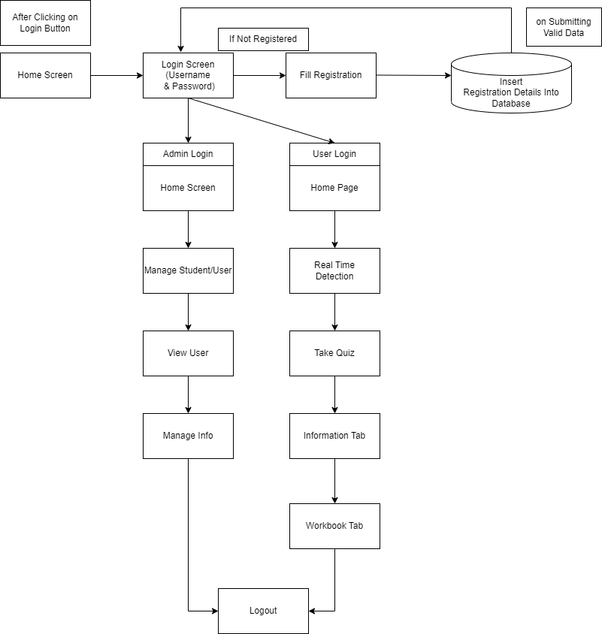
System Architecture

Slide 13
Emotion Detection Dataset
Kaggle Link to the dataset - https://www.kaggle.com/c/challenges-in-representation-learning-facial-expression-recognition-challenge/data
The data consists of 48x48 pixel grayscale images of faces. The task is to categorize each face based on the emotion shown in the facial expression in to one of five categories ('Angry','Happy','Neutral','Sad','Surprise').
It contains two columns, "emotion" and "pixels". The "emotion" column contains a numeric code ranging from 0 to 4, inclusive, for the emotion that is present in the image. The "pixels" column contains a string surrounded in quotes for each image

Slide 14

Workflow
A video of 10seconds will be captured and multiple frames will be extracted using cv2.VideoCapture(0)
Using cvtColor() method from open-cv the frame(image) is converted into a grayscale image
The main reason why grayscale representations are often used for extracting descriptors instead of operating on color images directly is that grayscale simplifies the algorithm and reduces computational requirements.

Slide 15
Workflow - continued
3. Using CascadeClassifier pre-trained model which uses haar cascade algorithm to detect the facial part from the video frame by drawing a rectangular box around the face.
One of the popular algorithms for facial detection is “haarcascade”. It is computationally less expensive, a fast algorithm, and gives good accuracy.
Initially, the algorithm needs a lot of positive images (images of faces) and negative images (images without faces) to train the classifier.
The Output being a window or a rectangle i.e the position of the face in the image.

Slide 16
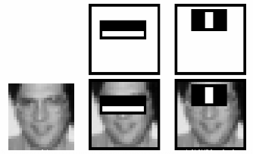
Haar Classifier
For example, consider the image below. Top row shows two good features. The first feature selected seems to focus on the property that the region of the eyes is often darker than the region of the nose and cheeks. The second feature selected relies on the property that the eyes are darker than the bridge of the nose. But the same windows applying on cheeks or any other place is irrelevant.

Slide 17
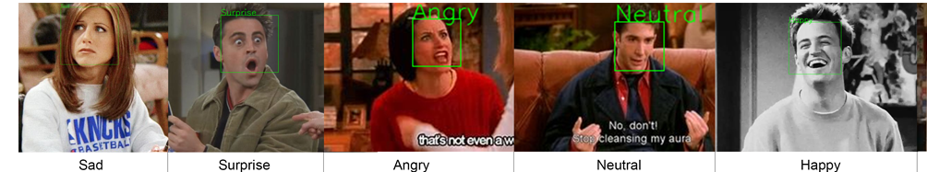
Further Steps
4. After extracting the facial part now the image is resized by keeping the aspect ratio intact using cv2.resize()
5.Image is converted into an array of pixels and then data is spilt into training and testing data and then a sequential model is built and the algorithm used is CNN.
6. An array of classified labels is returned and the class label occuring the most number of times is the final output returned.
7. If the final output is either sad or angry then the user needs to take a quiz.

Slide 18
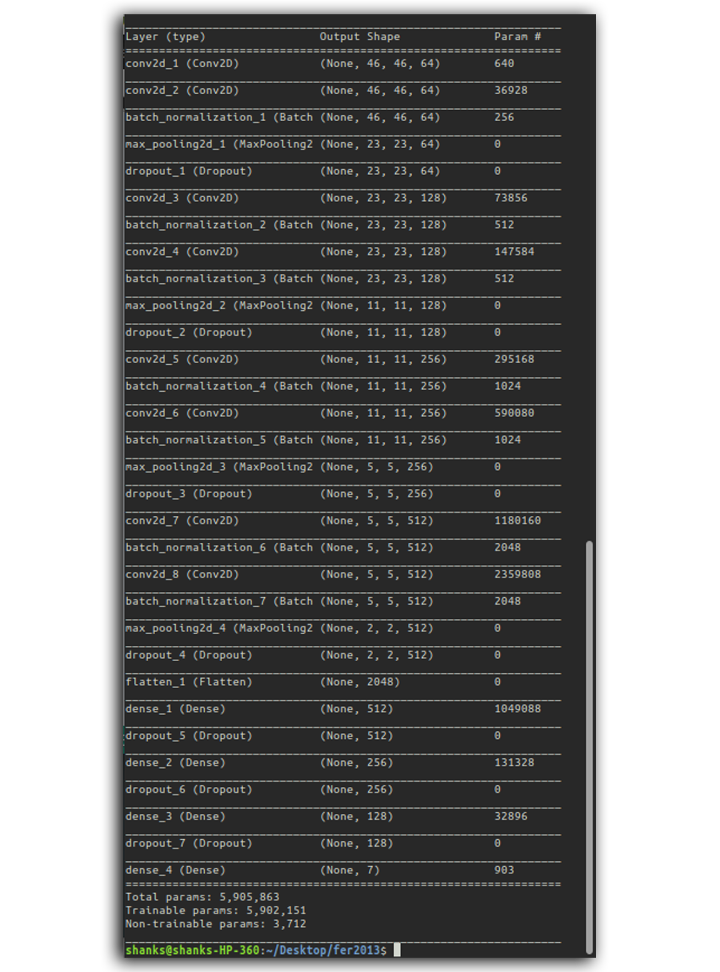
Model Summary

Slide 19
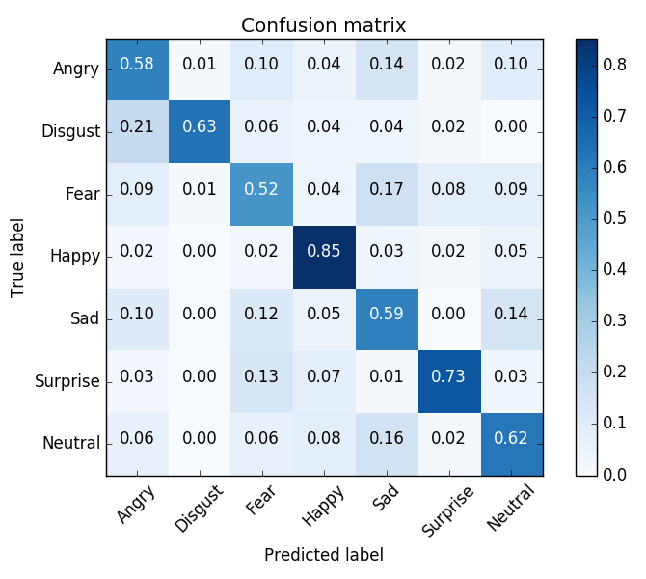
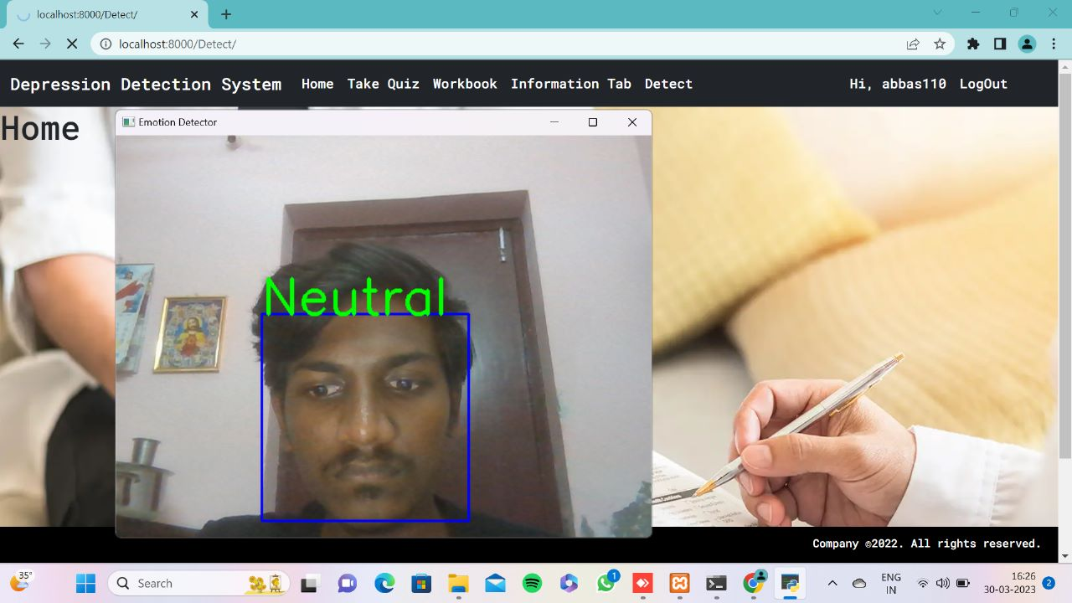
Results

Slide 20
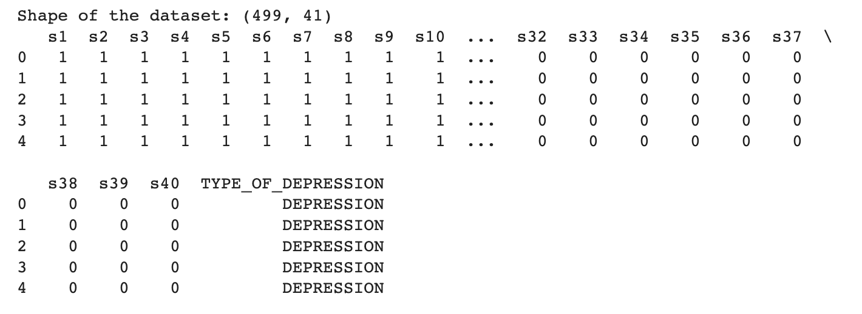
Quiz Dataset Description
Number of Features(Independent Variables) – 40
With Each Feature representing a question which has a Yes/No answer.
Class Labels - ['DEPRESSION', 'Anxiety', 'PTSD', 'Bipolar’]

Slide 21
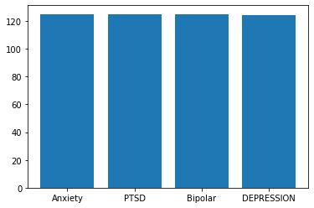
Data Visualization

Slide 22
XGBoost
XGBoost, which stands for Extreme Gradient Boosting, is a scalable, distributed gradient-boosted decision tree (GBDT) machine learning library. It provides parallel tree boosting and is the leading machine learning library for regression, classification, and ranking problems.
It’s vital to an understanding of XGBoost to first grasp the machine learning concepts and algorithms that XGBoost builds upon: supervised machine learning, decision trees, ensemble learning, and gradient boosting.

Slide 23
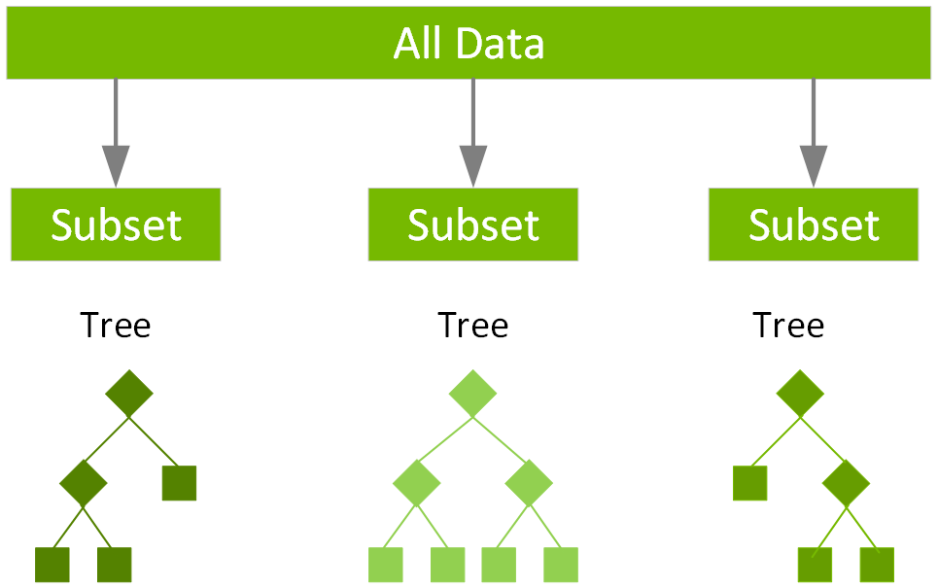
Gradient Boosting
Gradient boosting is a type of machine learning boosting. It relies on the intuition that the best possible next model, when combined with previous models, minimizes the overall prediction error. The key idea is to set the target outcomes for this next model in order to minimize the error.

Slide 24
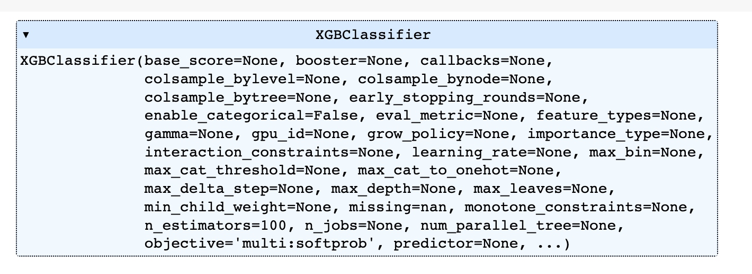
Model Summary

Slide 25
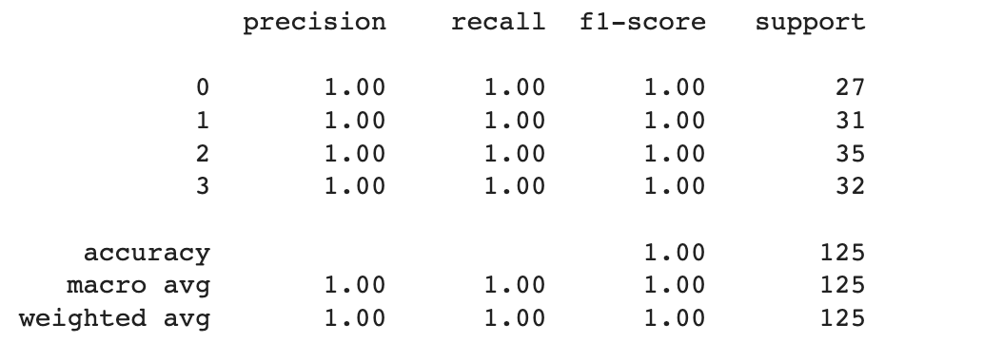
Further Steps
After Splitting the dataset into train and test data in the order of 75% and 25%, and then data is fed to the XGBClassifier Model and then validation is done using K-Fold cross Validation with the number of iterations being 5. In every Iteration the accuracy of the model is found out using classification_report and also the feature importance is also plotted in every iteration, as show in the next slide.

Slide 26
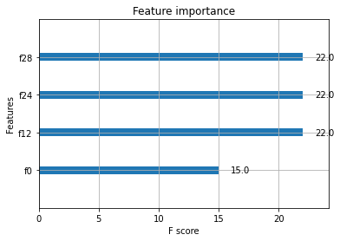
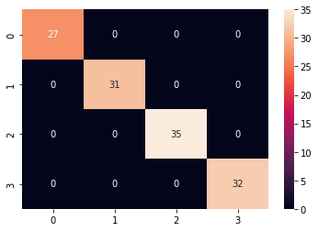
Visualization
Confusion Matrix
Feature Importance

Slide 27
Thank you

